Slide 1





24 Hour Hackathon
SUBSECTION ROUND
Team Name: Codecrew
Team Leader's Name: Shahir Mansur Ahamed
Team Members: 4
Institution: Yenepoya Institute of Technology, Moodbidri

Slide 2

Problem Statement
Title: What are we solving? Students and professionals often struggle to identify their real skills and choose the right training paths to stay employable in a fast-changing job market. At the same time, recruiters lack reliable tools to objectively assess practical abilities, leading to mismatched hiring and wasted potential. Urgency/Relevance: With industries evolving rapidly, there is an urgent need for an AI-based skill assessment platform that provides personalized training recommendations and bridges the growing industry–academia skill gap.

Slide 3
Motivation & Importance
Why this problem matters? The modern workforce is rapidly moving toward skill-based hiring, yet most individuals lack personalized guidance to identify and improve their true capabilities. This results in skill gaps, lower employability, and inefficient hiring processes. Who is affected (Target Audience): Students & Graduates — struggle to align with industry-relevant skills.
Recruiters & Companies — face mismatched candidates and hiring inefficiency.
Educational Institutions — lack data-driven tools to track student skill development.

Slide 4
Supporting Facts: 87% of employers report skill gaps in their workforce.
60% of graduates feel unprepared for real-world job requirements.
The global skill shortage could leave 85 million jobs unfilled by 2030 (World Economic Forum).
Big Insight: There is a critical need for an AI-driven system that can accurately assess skills and guide individuals with personalized training paths, empowering both learners and employers.

Slide 5
Proposed Solution
Statement:
SkillLens is an AI-powered platform that evaluates users’ skills through adaptive assessments and provides personalized training recommendations to bridge their learning gaps.
Key Features:
AI-driven adaptive testing that adjusts to user performance.
Personalized learning recommendations mapped to individual strengths and weaknesses.
Skill analytics dashboard for users, institutions, and recruiters.
Integration with learning platforms (Coursera, Udemy, etc.) for immediate course access.

Slide 6
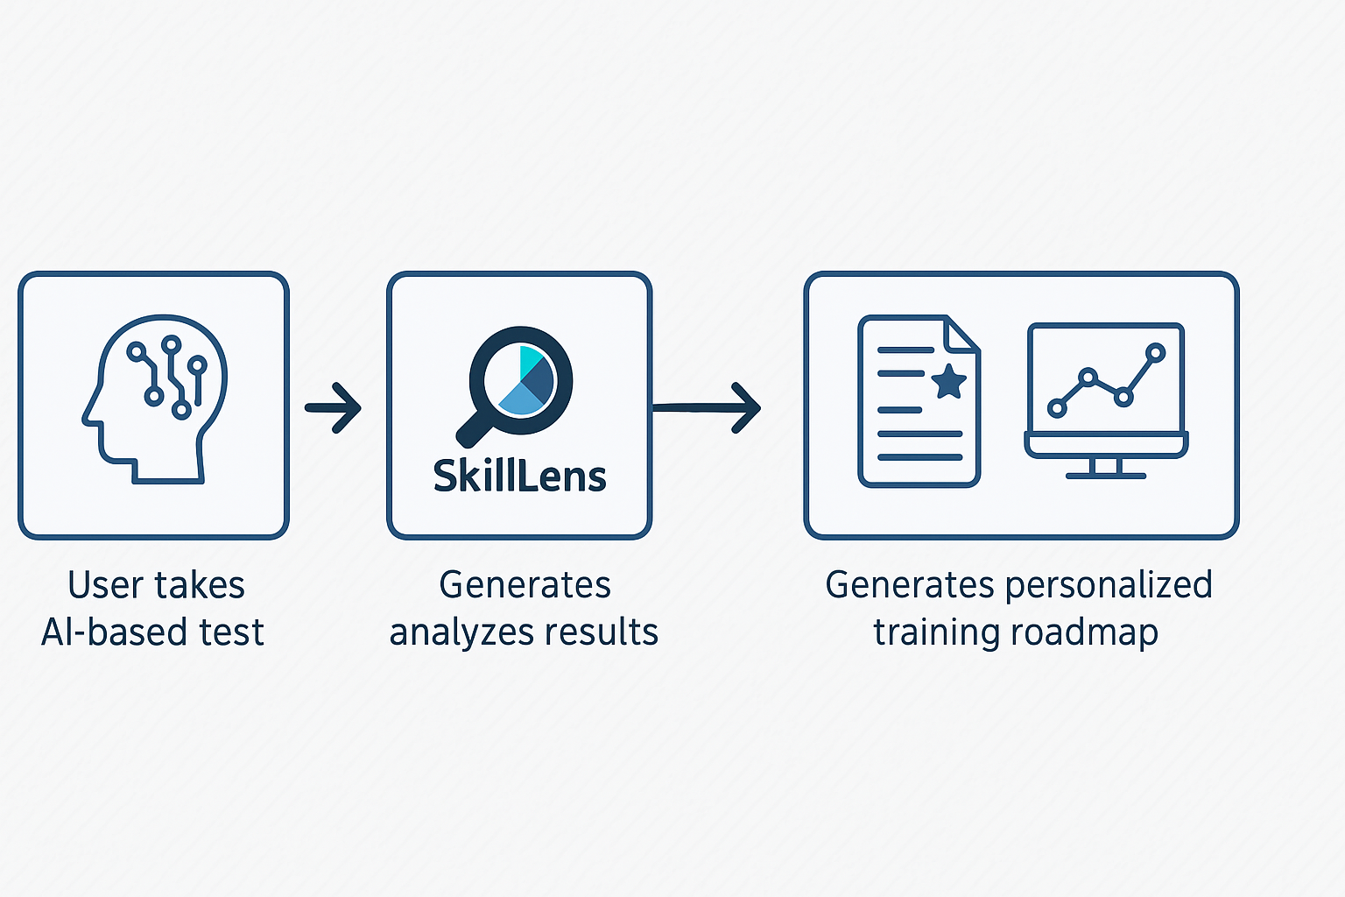
Flow Diagram:

Slide 7
Solution Statement:
SkillLens empowers individuals and organizations with AI-driven skill insights and personalized learning paths — bridging the gap between talent and opportunity.

Slide 8
Innovation & Uniqueness
What makes your idea different from existing solutions?
Existing Solution | Our Solution/Approach
Generic assessment platforms focus only on theoretical or multiple-choice questions. | SkillLens uses AI-driven adaptive assessments that evaluate both theoretical knowledge and practical application.
Learning platforms provide courses but lack personalized guidance. | SkillLens offers personalized training recommendations based on skill gap analysis.
Traditional hiring tools measure resumes, not real skills. | SkillLens provides data-driven skill insights through interactive tests and analytics, enabling evidence-based hiring.
One-size-fits-all systems fail to track progress effectively. | SkillLens includes a continuous progress tracker that visualizes improvement and suggests next-step learning goals.

Slide 9
Implementation Plan
High-level Roadmap:
Phase 1: Research & Design
Conduct detailed research on existing skill assessment tools and AI models.
Identify key skill domains (technical, business, creative, etc.).
Design system architecture and user flow for adaptive assessments.
Phase 2: Development
Build the AI-based assessment engine and recommendation system.
Develop the user interface and dashboard for analytics.
Integrate APIs with online learning platforms (Coursera, Udemy, etc.).
Phase 3: Testing & Deployment
Conduct pilot testing with students and institutions.
Refine model accuracy and recommendation logic.
Deploy the MVP version and gather feedback for scaling.

Slide 10
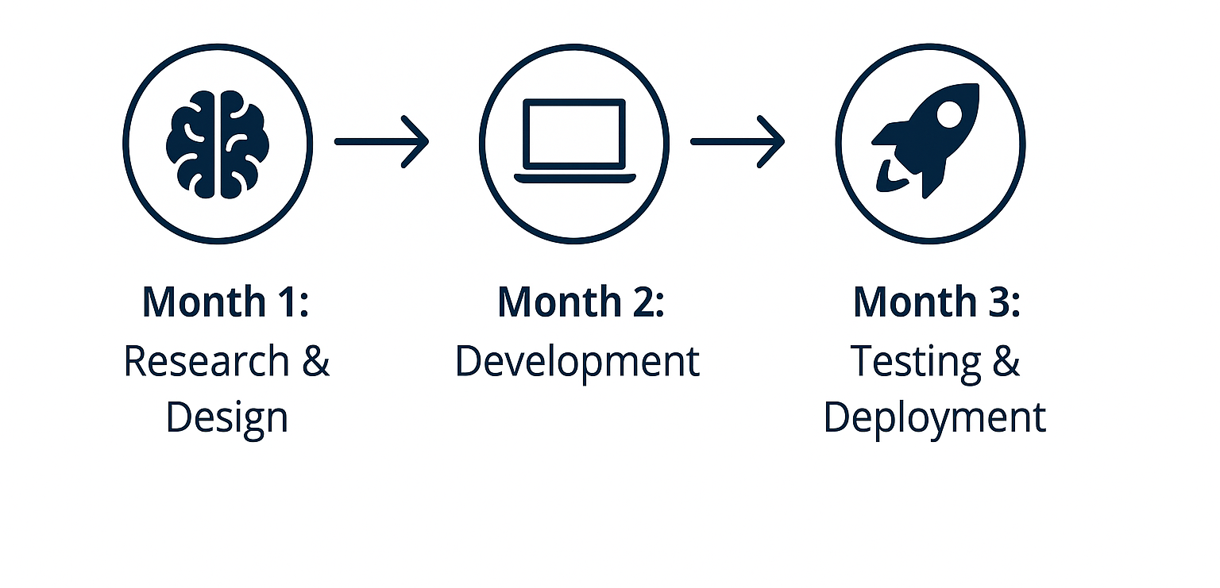
3-Month Development Cycle

Slide 11




Impact & Benefits
Social / Economic / Technological Impact:
SkillLens helps bridge the industry–academia skill gap by providing personalized learning pathways, improving employability, and fostering a data-driven upskilling culture.
Who will benefit:
: Students & Graduates — gain clear visibility into strengths, weaknesses, and training needs.
: Recruiters & Companies — access reliable, AI-based skill insights for smarter hiring.
: Educational Institutions — track student performance and align courses with market demand.
: Society — benefits from a more skilled, future-ready workforce.

Slide 12
Key Impacts:
Enhances employability through targeted skill development.
Empowers data-driven hiring and workforce planning.
Accelerates upskilling using AI-powered recommendations.
Bridges the academic-industry divide effectively.

Slide 13
Team Intro
Shahir Mansur Ahamed(Team Lead & AI Developer)-Leads the project and develops the AI-based assessment model.
Shaaz Isaque Sayyed(Backend Developer)-Builds backend systems and integrates APIs with learning platforms.
Sheikh Sohali Fathima(UI/UX Designer)-Designs the dashboard and user interface for smooth user experience.
Tayyaba(Research & Presentation Lead)-Handles research, data analysis, and prepares the final presentation.

Slide 14
Mentor & Institution Acknowledgement
Institution: Yenepoya Institution of Technology, Moodbidri
Mentor: Prof. Praveen M Ullagaddi Department of Electronics & Communication Engineering
We express our sincere gratitude to our mentor and institution for their constant guidance, encouragement, and support throughout the development of SkillLens. Their valuable insights and feedback played a crucial role in shaping our idea into a practical solution.

Slide 15
Why our idea deserves to win
We deserve to win because SkillLens creates a future where every learner knows their worth and every employer finds real talent.

Slide 16
Contact info
Shahir Mansur Ahamed: Shahirahmd01@gmail.com Shaaz Isaque Sayyed: shaazsayyed10@gmail.com
Sheikh Sohali Fathima: Sheikhsoha2117@gmail.com
Tayyaba: Tayyaba.shk1234@gmail.com

Slide 17
Thank You

